Slide 1

Mental health analysis module code: 4FTC2113
Student ID:25001700
NAME: Yadavi Shreedhar

Slide 2
Introduction
Many individuals experience mental distress but do not seek treatment. Understanding predictors can improve early intervention can be framed as a binary classification problem.
Business Problem: Identify at-risk employees for workplace interventions
Approach: Binary classification using Logistic Regression

Slide 3
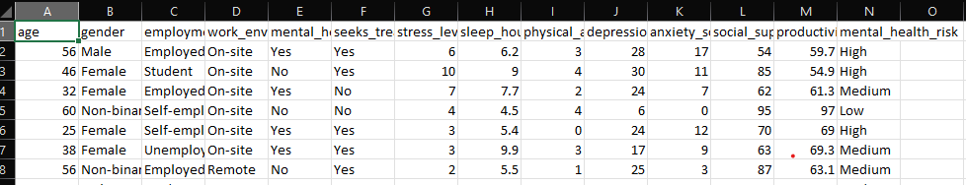
Dataset overview
10,000 observations
Demographic + psychological + lifestyle features
Binary target (Yes/No)
Target Variable: seeks_treatment (Yes/No)
Key Features:
Depression score, Anxiety score
Stress level, Sleep hours
Social support score
Work environment, Gender

Slide 4
Data preprocessing and feature engineering
Verified no missing values
Encoded categorical variables (one-hot encoding)
Feature engineering:
mental_health_composite = depression + anxiety - social_support
stress_category (Low/Medium/High)
Outlier treatment
Train-test split (80/20 with stratification)

Slide 5
Logistic regression
Logistic Regression classifier
80/20 stratified split
Balanced class weights to address class imbalance
Evaluated using Accuracy, ROC-AUC, Confusion Matrix
Why?
Interpretable
Probabilistic output
Efficient
Baseline model

Slide 6
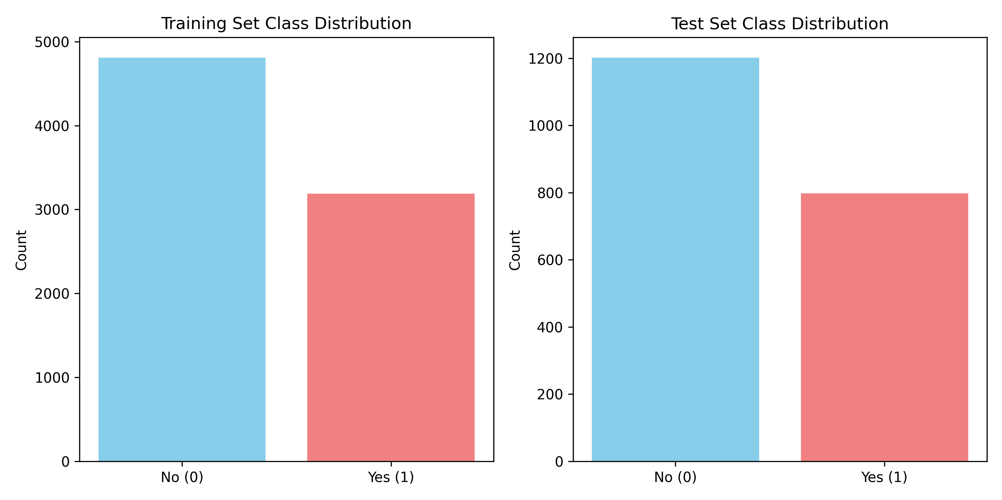
Class Distribution
Training : 4,800 No (60%), 3,200 Yes (40%)
Testing : 1,200 No (60%), 800 Yes (40%)

Slide 7
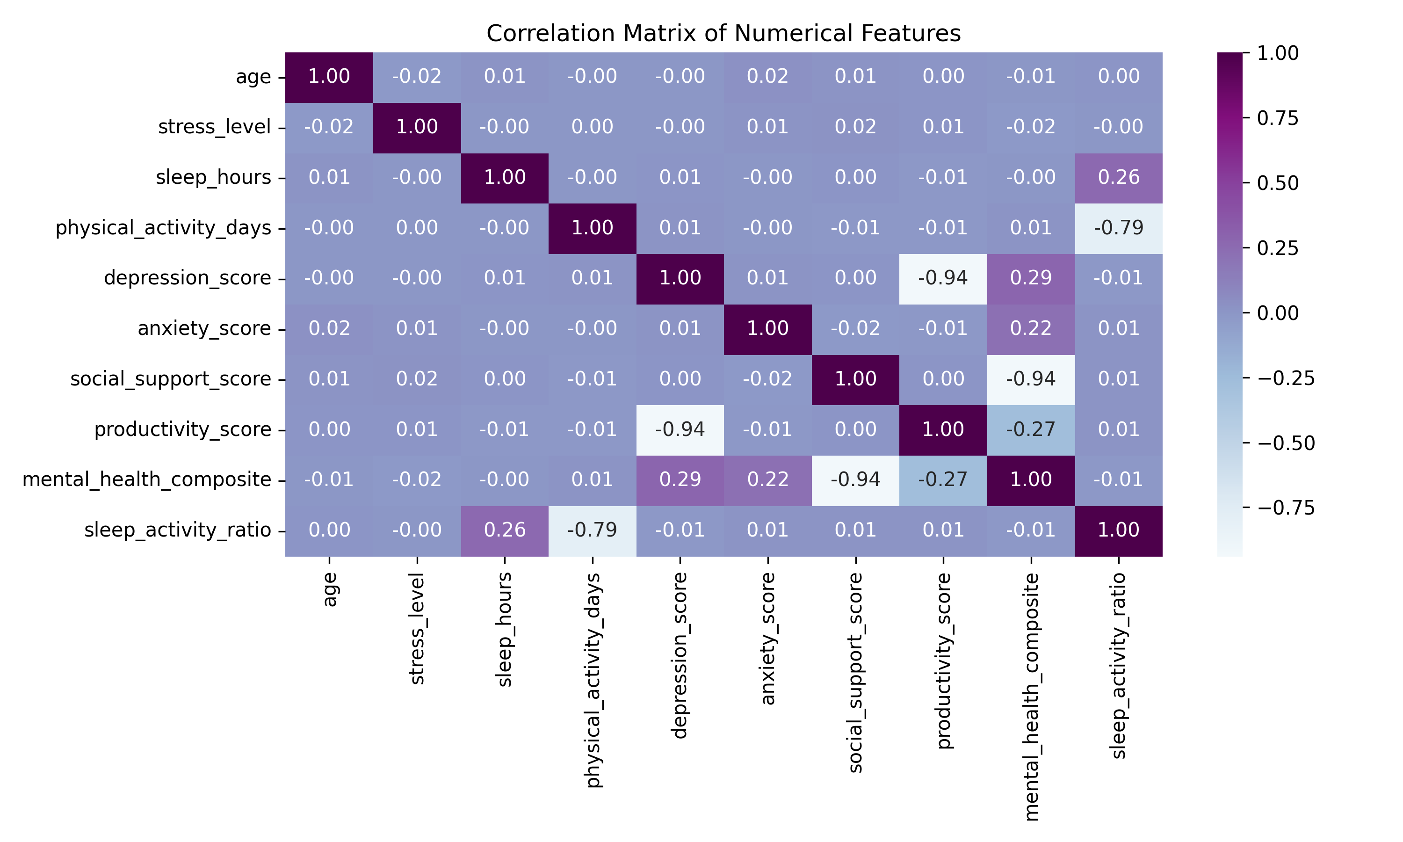
Correlation Matrix
Notes:
Strong positive correlation (0.94) between depression and anxiety scores

Slide 8
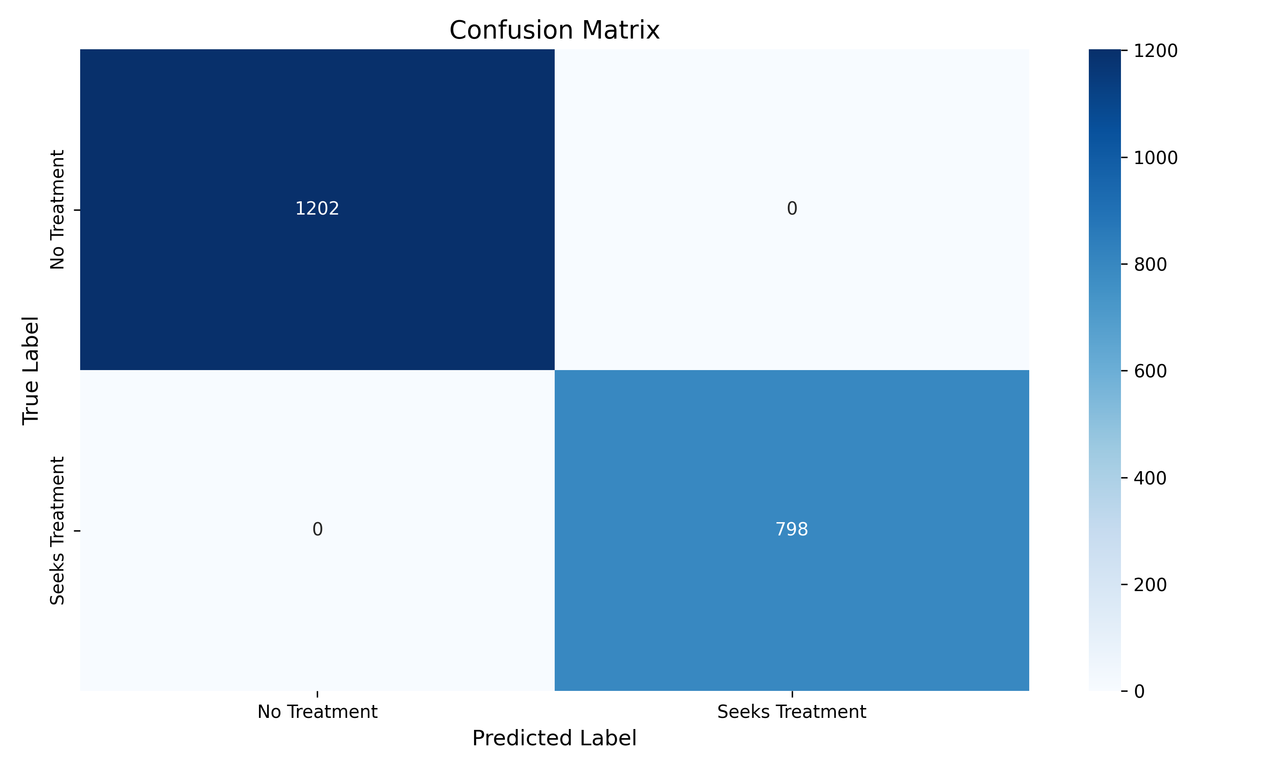
Confusion Matrix
Notes:
1202+798=2000 prediction on test data.

Slide 9
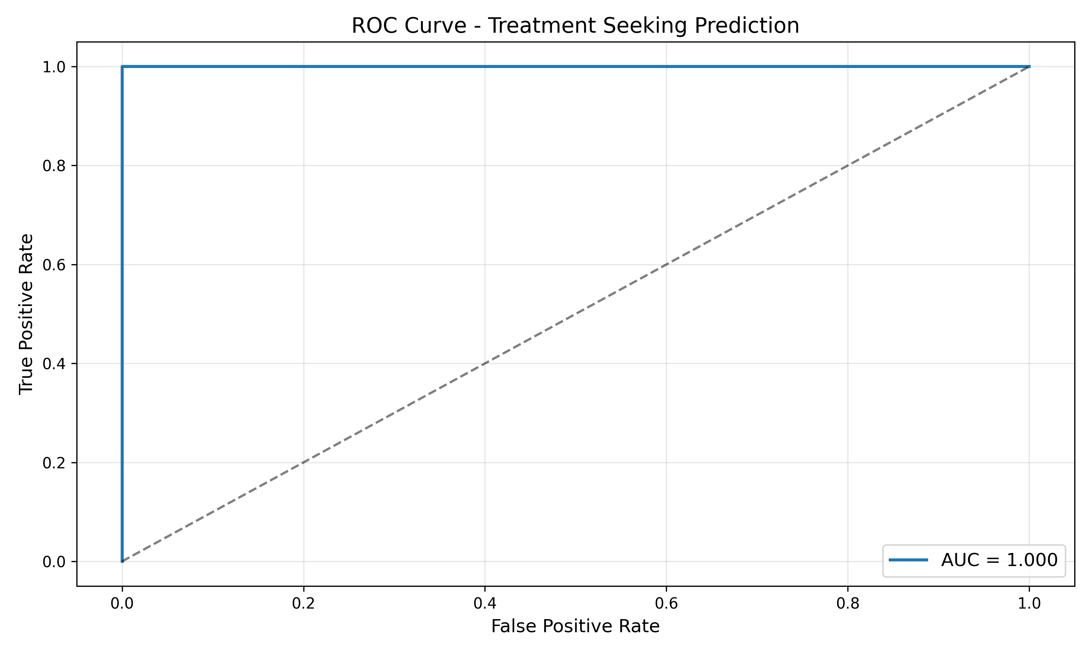
ROC curve

Slide 10
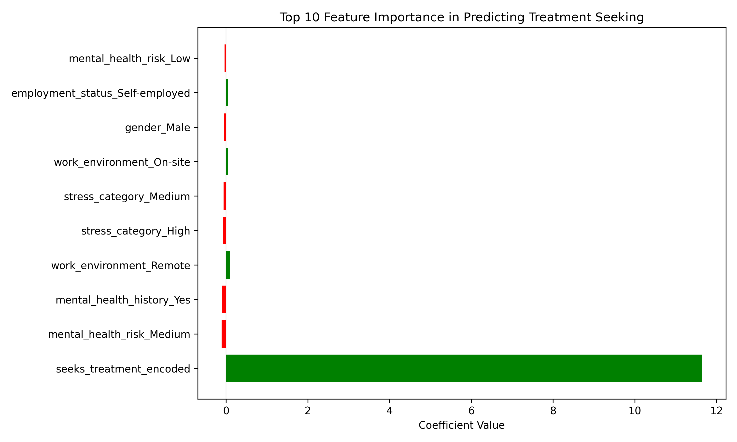
Feature Importance
Notes:
This bar chart shows what drives treatment-seeking behavior
The model suggests low mental health risk individuals are actually most likely to seek treatment

Slide 11
Key insights
Perfect performance indicated target leakage
Critical model validation is required
Weak individual correlations are observed.
Behavior likely influenced by multivariate interactions
Notes:
Behaviour likely influenced by multivariate interactions

Slide 12

Future suggestions and Limitations
Target leakage affected performance
Self-reported data bias
Dataset may not generalize
Future: Random Forest comparison
Future: Leakage-free pipeline
Notes:
Target leakage affected performanceSelf-reported data biasDataset may not generalizeFuture: Random Forest comparisonFuture: Leakage-free pipeline

Slide 13
Conclusion
Built an interpretable model with 100% accuracy
Perfect performance revealed data leakage.
Model validation is important than high accuracy
Actionable insights for workplace mental health programs
Future work: Try Random Forest, which includes more features and has more data.
Notes:
More features – cultural and financial data

